Slide 1

Nonprofit Data
Research Seminar Series

Slide 2
The big bird gets the worm? How size influences social networking behaviour by charitable organisations
Dr Tom Wallace
University of Stirling
tom.wallace@stir.ac.uk
Prof Alasdair Rutherford
University of Stirling
alasdair.rutherford@stir.ac.uk
https://github.com/tomwallace1990/Big_bird

Slide 3
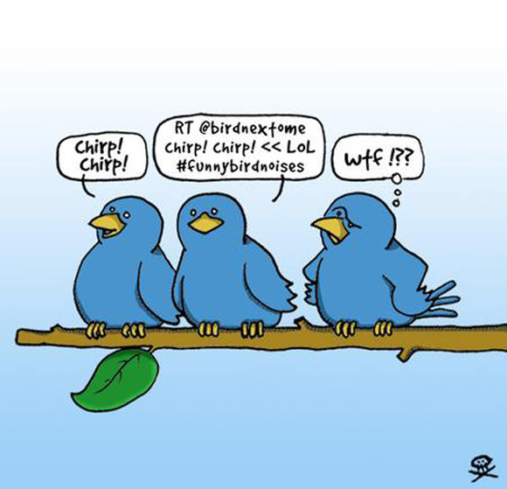

Slide 4
Introduction
Twitter is a global phenomenon
Trump, Fake news, Arab Spring
Charities rely on relationships and many use Twitter
Existing research has covered how charities communicate with their publics and build communities with social media
Very little research has attempted to map non-profits on social media quantitatively or with SNA

Slide 5
Size
Resources and funding tend to inhibit smaller charities from adopting new technology as fast or as far as their larger counterparts
Social media may be different from previous technologies due to its low cost and skills requirements
A handful of studies have argued that Twitter and other social media platforms ‘level the playing field’ (Svensson et.al. 2015) for smaller charities, but the existing literature lacks methodological robustness with respect to it’s treatment of size
Nah & Saxton (2013) called for future research to utilize random sampling
Notes:
Computing systems in the 90s, websites in the 2000s, etc

Slide 6
Research questions
Does organisational size affect the likelihood of Twitter handle ownership?
Does size effect the level of use of the platform?
Does size affect the dynamics of charity to charity interactions and the structure of the network which emerges from this interaction?

Slide 7
Random sampling
Random sampling brings benefits familiar to most quantitative researchers; increased generalizability and more robust hypothesis testing
In the case of charity social media use, and the investigation of size, it is particularly important because the third sector in most (if not all) countries is highly skewed with a few very wealthy charities and a much larger number of smaller organisations.
The most common way of generating a sample in the previous literature is ‘top-100’ style sampling which is obviously incompatible with measuring the effects of organisational size
However, this skew also means true random sampling presents a problem – over representation of smaller charities
Notes:
Over representation in sample terms. Proportionally correct but this would be analysis tricky!

Slide 8
Random sampling
Our solution: stratified random sampling
We chose England and Wales due to the availability of suitable data and our familiarity with the sector
Data set produced by Alcock & Mohan
Used income as measure of size
Used income bands
from the NCVO
Group
Small (10k-99k)
Medium (100k-999k)
Large (1m-9.9m)
Major (10m+)

Slide 9
Random sampling
Split the most populous year of the data into the income bands and then used an RNG to randomly draw charities from the bands
Drew 200 charities for each band (but more on this later)
Excluded some records based on key words (‘school’, ‘church’, ‘university’)
The Alcock & Mohan data does not contain every charity but is itself a stratified random sample of the entire sector which aims to collect a higher proportion of larger charities
This was not a problem because although we used fewer strata, our income bands did not cross with any of theirs
Never cross the bands!
Notes:
Excluded are usually regulated by another body

Slide 10
Random sampling
Handles for this sample of 800 charities then had to be collected from Google – 40 for each of the 4 size groups cutting 800 to 160
Sample over-drawn because not all charities had a handle
Collection stopped once 40 had been obtained
Collection manual ☹
Data for the resulting 160 handles was collected with NodeXL
Usage metrics
Follower/following links collected (not mentions)
Notes:
Google search better than Twitter

Slide 11
Results

Slide 12
Handle ownership
Size grouping handle ownership was very stratified with less than ¹/₃ of small orgs on twitter compared to 83% of major charities.
Group | % with twitter handle (searches performed)
Small (10k-99k) | 27% (147)
Medium (100k-999k) | 45% (88)
Large (1m-9.9m) | 62% (65)
Major (10m+) | 83% (48)
n=348 gamma=0.57 Pr=0.000
Notes:
Even at 83% not quite the universal platform some have suggested

Slide 13
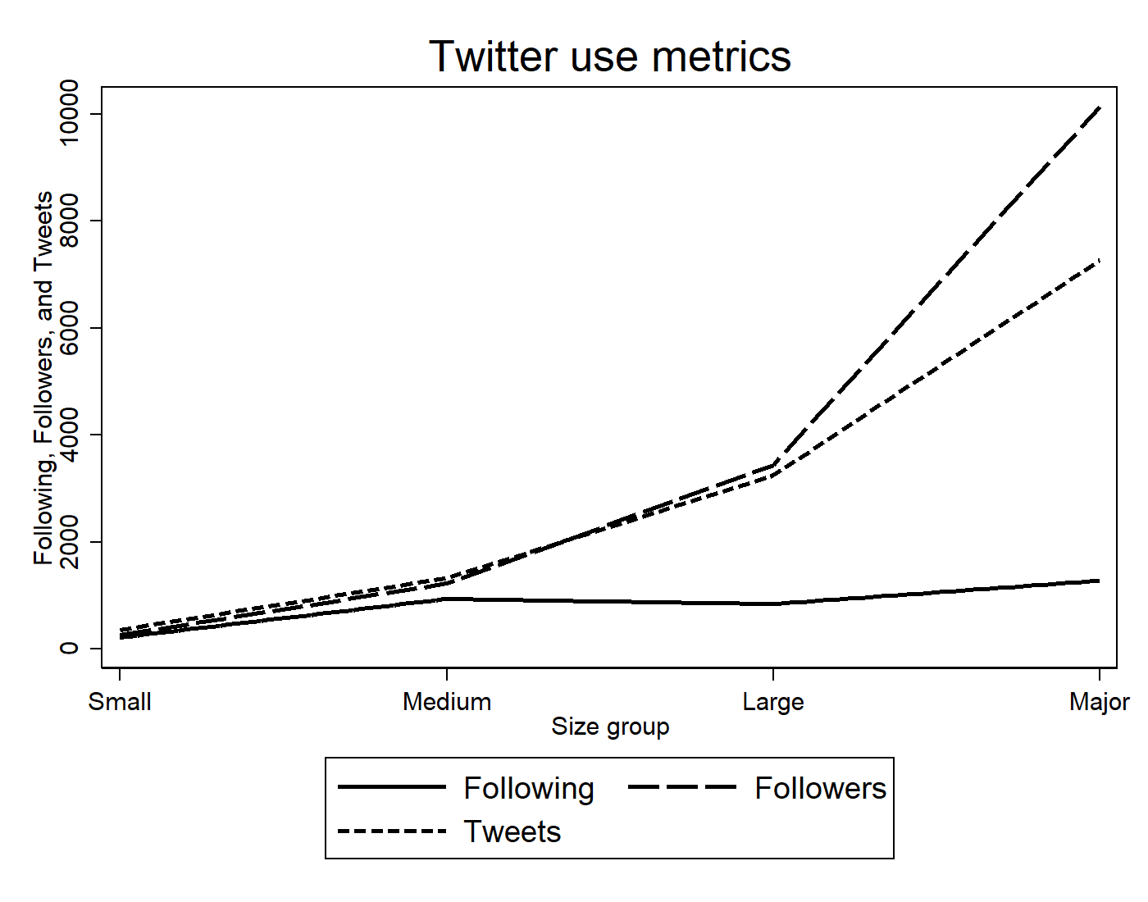
Twitter usage
Notes:
Despite last slide have 40 of each group due to way sampled. So no 40 from each are on twitter is there a difference in how they are using it?
First bar is <2000

Slide 14
Network connection
Connected | Yes | No
Small £10K - £99K | 11 (27.5%) | 29 (72.5%)
Medium £100K - £999K | 27 (67.5%) | 13 (32.5%)
Large £1M - £9M | 32 (80.0%) | 8 (20.0%)
Major £10M+ | 31 (77.5%) | 9 (22.5%)
Total | 101 (63.1%) | 59 (36.9%)
n=160
gamma=0.44
Pr=0.000
Intergroup connections |  | Receiving group (in degree)
 |  | Small | Medium | Large | Major
Sending Group (out degree) | Small | 0 | 1 | 7 | 9 | 17 | Out total
 | Medium | 3 | 9 | 28 | 60 | 100
 | Large | 4 | 19 | 15 | 60 | 98
 | Major | 3 | 22 | 39 | 80 | 144
 |  | 10 | 51 | 89 | 209
 |  | In total
Notes:
This is just following within the network of 160

Slide 15
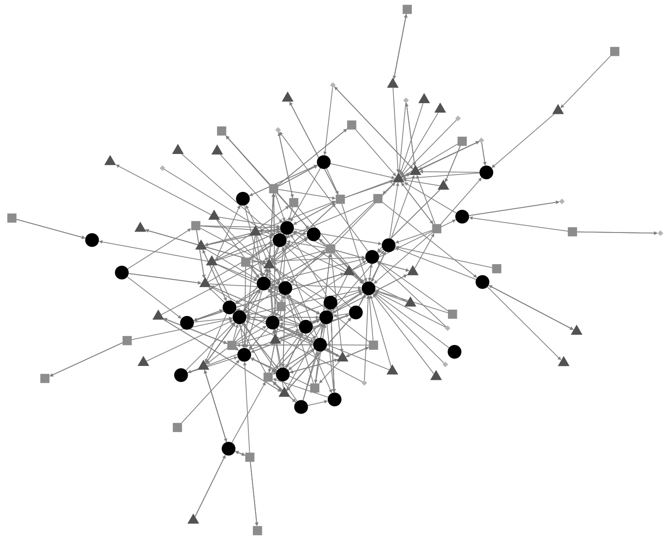
Key: small (lightest grey diamonds), medium (medium grey squares), large (dark grey triangles), major (black disks).

Slide 16
Network modelling: ERGM
Can’t model networks with normal methods
Assumption of independence of observations
Exponential Random Graph Models use MCMC
Generates many random networks of same size and density of input network
Automatically tunes specified structural parameters to produce networks like the input network – these parameters become the coefficients
In effect, determines how different input network is from random, on the specified measures (measures include reciprocity, triangles, popularity, etc)
Factors control for each other
Complicated to estimate and interpret – can take days to converge! But powerful

Slide 17
Network modelling: ERGM
We use Pnet to estimate ERGMs, there is also a package for R
3 models presented below
1. Endogenous model – only internal effects
2. Continuous model – size measured by income
3. Binary group model – Income bands as used above
Will make more sense as we go through below

Slide 18
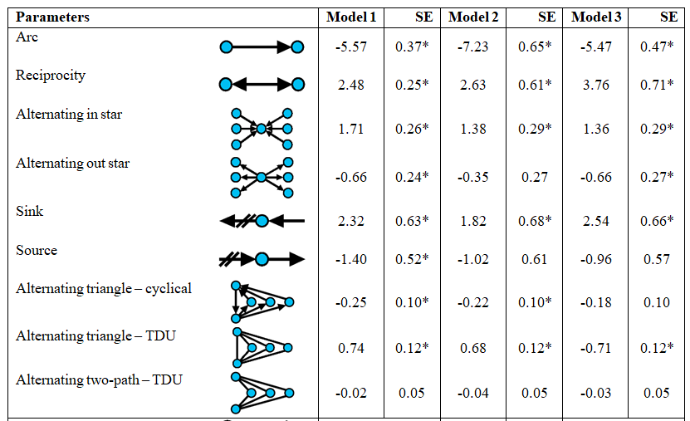
1. Endogenous model
Notes:
Don’t look at arc (intercept in reg), reciprocity positive, pop and activity effects, weak triangles/two-path. Sinks are probably large charities

Slide 19
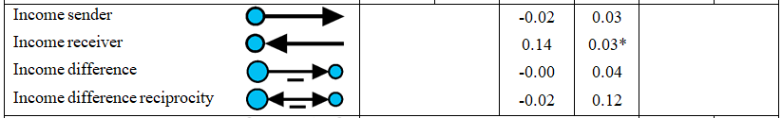
2. Income model
Only 4 extra effects
1 significant – income receiver meaning larger charities tend to receive more follows (are more popular)
Drop in generic popularity
In-star: 1.7 > 1.4
Sink: 2.3 > 1.8

Slide 20
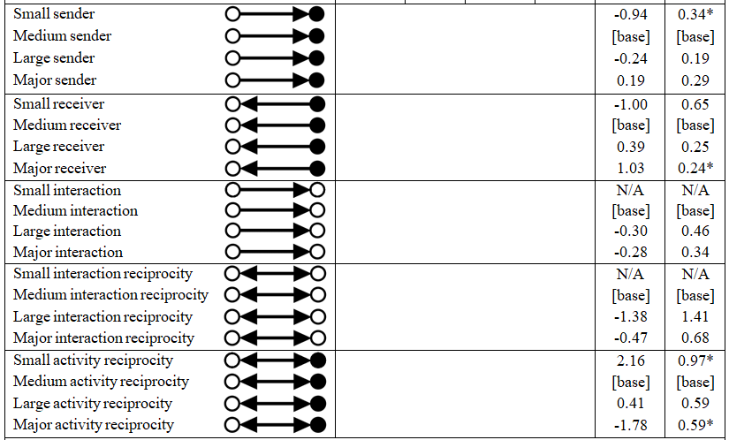
3. Binary model
dssd

Slide 21
3. Binary model
Medium is reference category
Lots of numbers but only a few really matter here!
Major reviver: 1.0* (Very large charities are more popular)
Small sender: -0.9* (small charities follower fewer other charities)

Slide 22
Conclusion
Big charities being more popular on Twitter isn’t a surprise
But the ERGM modelling shows that small charities are less likely to follow other charities, they are less active
They are also less likely to be connected to the network altogether and less likely to own a handle
It is apparent that Twitter is not the great leveller for smaller organisations – it still takes a lot of time to build up a presence and small organisations are often lacking in time and staff

Slide 23
Future work & improvements
The most obvious improvements to this research are increasing the sample size, and comparing the results to a non-stratified random sample
Both of these would benefit from automated Twitter handle collection, but achieving that would be a paper in itself!
This research also sets a foundation for other features of charities to be considered in their use of social media or for mentions to be mapped alongside follows

